Slide 1
Thevenin / Norton Circuit & Maximum power transform.

Slide 2
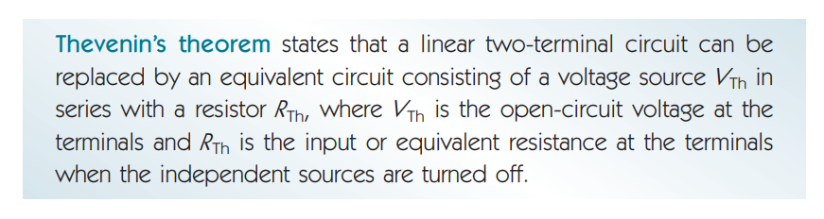

Slide 3
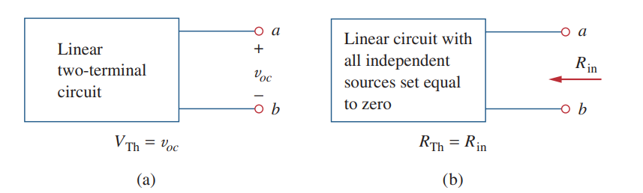
Key points:

Slide 4
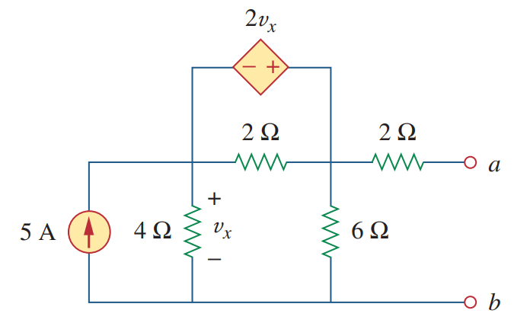
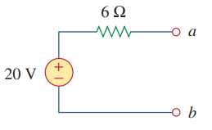
Why Thevenin:

Slide 5

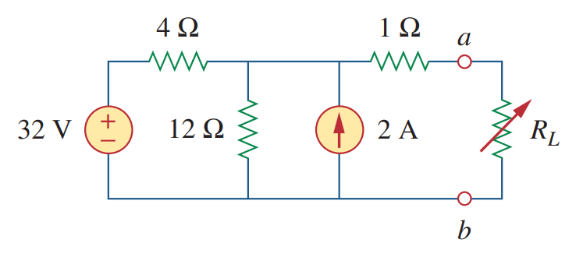
Math Problem Practice:
Reference: Sadiku_Example_4.8

Slide 6
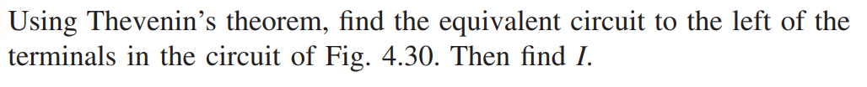
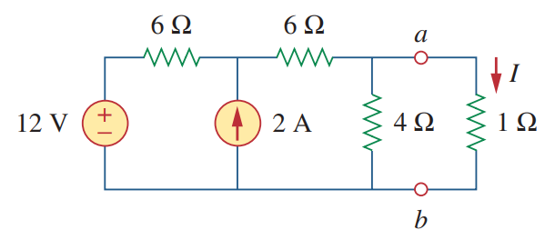
Math Problem Practice:
Reference: Sadiku_Practice_Problem_4.8

Slide 7
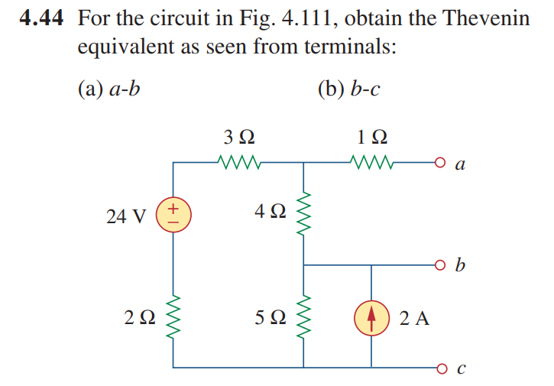
Math Problem Practice:
Reference: Sadiku_Exercise_4.44

Slide 8
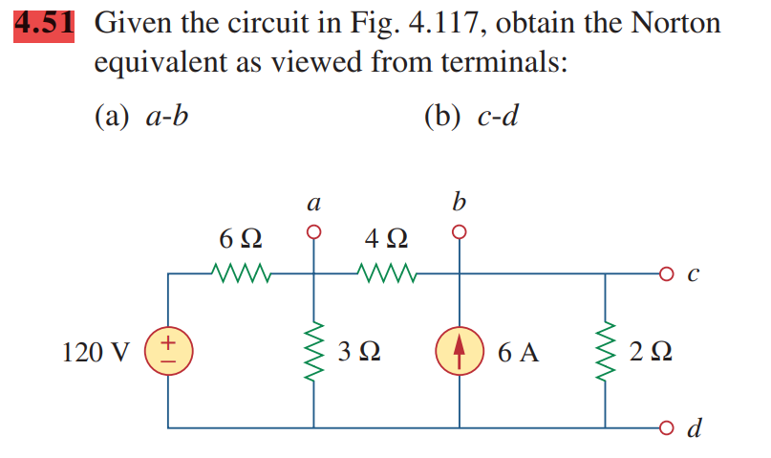
Math Problem Practice:
Reference: Sadiku_Exercise_4.51

Slide 9
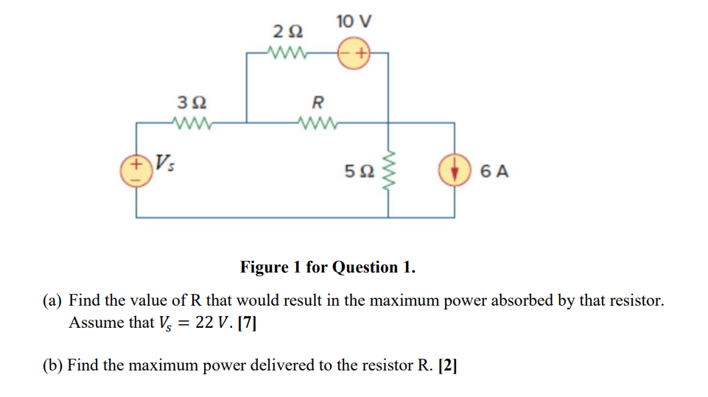
Math Problem Practice:
Fall 2022

Slide 10
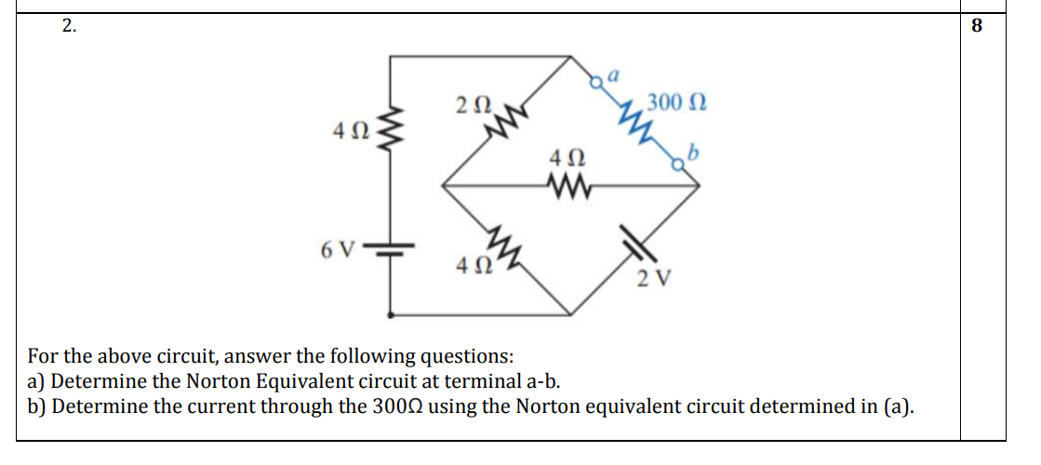
Math Problem Practice:
Spring 2022

Slide 11

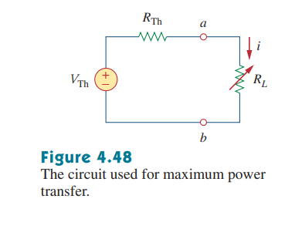
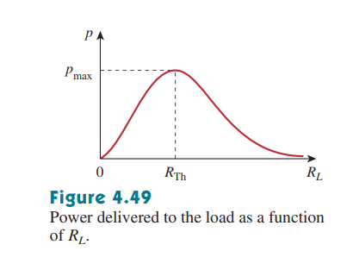
Maximum Power Transfer

Slide 12

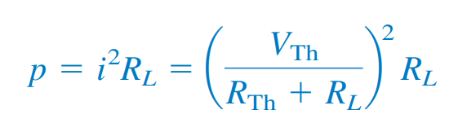
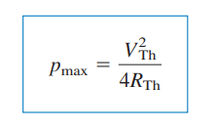
Maximum Power Transfer

Slide 13
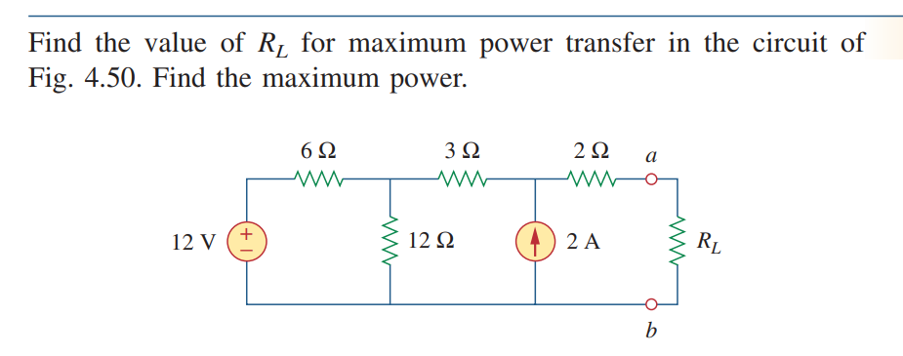
Math Problem Practice:
Reference: Sadiku_Example_4.13

